Slide 1


Optimizing Energy Consumption through Fuzzy Logic Speed Recommendations and Door Opening Alert
PROJECT TITTLE:
TEAM NAME:
Tech Titans
TEAM MEMBERS:
1Dharshini.P.G,
2.Vidhya s,
3.Poornimaraj G R.

Slide 2
INTRODUCTION
Fuzzy logic control system for a domestic refrigerator considering the status of the door.
Fuzzy logic system was set up to control the speed of the compressor.
Input – Frequency and Duration of Door opening.
GOALS – 1. Keep temperature of food compartment close to set point
2. Compressor speed should be at minimum.
3. Reduce the no.of. Times the compressor switches off.
4. Save Energy.

Slide 3
VAPOUR COMPRESSION METHOD
Compressor
Condenser
Expansion Valve
Evaporator
Refrigerant

Slide 4
CONTROL SYSTEMS
PID
continuously calculates an error signal based on the difference between a desired setpoint and the actual process variable
Precise mathematical models.
Requires certain I/O Relation.
3 comp- Proportional , Integral, Derivative control
FUZZY LOGIC
Uses linguistic variables and fuzzy rules.
Human like reasoning
Handles complex and non-linear systems.
Useful in systems with uncertain I/O relations
Has ”degrees of truth” , not “true”/”false”.

Slide 5
I/O and System
2 Inputs – Open door time and Actual temperature.
1 Output – Compressor speed and Alarming system.
Systems – Fuzzy system (measures duration of door being opened) and Interference system (Analyses the Status of door)
Process - Door opened: compressor speed reduced. (Fuzzy)
(Interference system ) reduces no of times the compressor is turned off and on, thus reducing electric peaks.
Also alarming the user about the loss of energy and prolonged opening of the door.

Slide 6
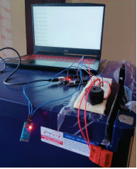
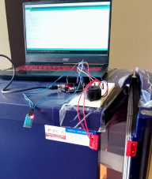
INSTRUMENTATIONS AND MEASUREMENTS
The MC-38 door opening sensor, based on a magnetic reed switch
The temperature sensor, such as a digital thermistor
The Arduino UNO, a versatile microcontroller board equipped with an ATmega328P microchip, is utilized as the central processing unit
The piezo buzzer which emits an audible warning sound.

Slide 7
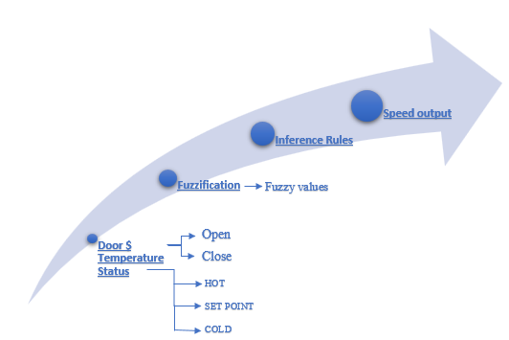
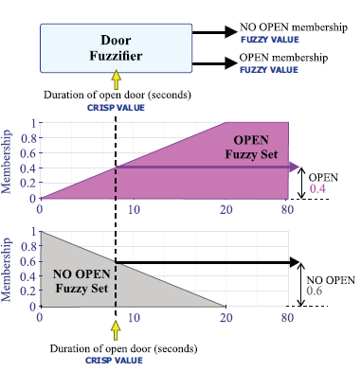
Fuzzy CS working
Door Fuzzifier.
Crisp – duration of opened door
Membership – Open/ No Open
The Door fuzzifier and Temperature fuzzifier takes in the i/p of door status in terms of binary values, setpoint and current temperature and produces the membership values – passes through interference rules to provide intermediate membership values of compressor speed.

Slide 8
HARDWARE and SOFTWARE
HARDWARE
Refrigerator
Plastic Temperature Sensor, Model Name/Number: NCP18WF104F3SRB.
MC-38 Wired Door sensor
Arduino UNO (main, door status).
Piezzo electric buzzer.
Jumper wires
SOFTWARE
Arduino IDE

Slide 9
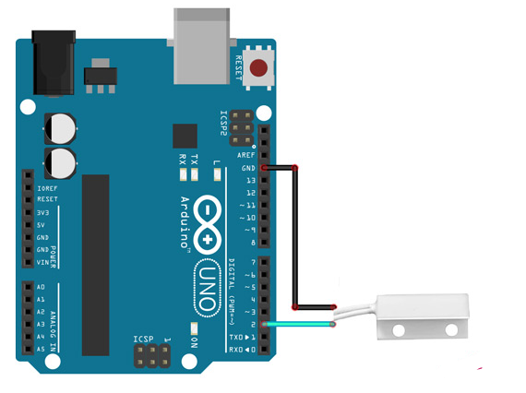
Door Status (2nd input to Arduino)
Sensor – MC-38 Wired Door Window Sensor
Microcontroller – Arduino UNO
Wiring- Connect one terminal of the magnetic reed switch to a digital input pin of the Arduino (e.g., pin 2) and the other terminal to the ground (GND) pin. To ensure stable readings, you can use a pull-up resistor by connecting a 10kΩ resistor between the digital input pin and the 5V pin on the Arduino. This will ensure a default HIGH state when the switch is open.
Code the Arduino
digitalRead() stores & prints o/p in serial monitor.
https://electropeak.com/learn/interfacing-mc-38-magnetic-reed-switch-with-arduino/

Slide 10
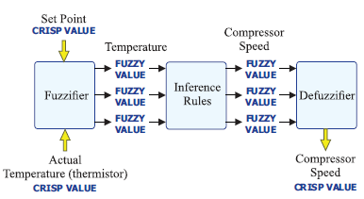
Arduino- Compressor speed
Inputs- o/p of temp thermistor & opening of door (sensor).
The Arduino Mega 2560 gets inputs from thermistor and Opening of Door.
PROCESS- Arduino coding –Fuzzy Logic.
Arduino produces the Recommended of the compressor as output.
Outputs are produced for every 10s.

Slide 11
Work Flow
Data Acquisition system → Thermistor fuzzy logic → (Hot, Set Point, Cold )
Door opening sensor → Door Fuzzy Logic → (Open, Not Open)
Interference Rules → Compressor Frequency (Off, Very Slow, Slow, Fast )
Percentage of speed recommendation.
Door opening time detected and stored
Based on DO time and fuzzy values of the temperature the buzzer alerts.

Slide 12
CONCLUSION
Used a Fuzzy Variable – represents the time duration when the door remained open.
Fuzzy logic system with the door at the minimum speed of the compressor produced an overall energy saving.
When the user opens the door, the system tries to reduce the speed of the compressor.
If the door remains open for a long time – the compressor turns to slow mode and with increase in heat the alarming system alerts.
Able to reduce Energy consumption based on the status of the door.

